Slide 1

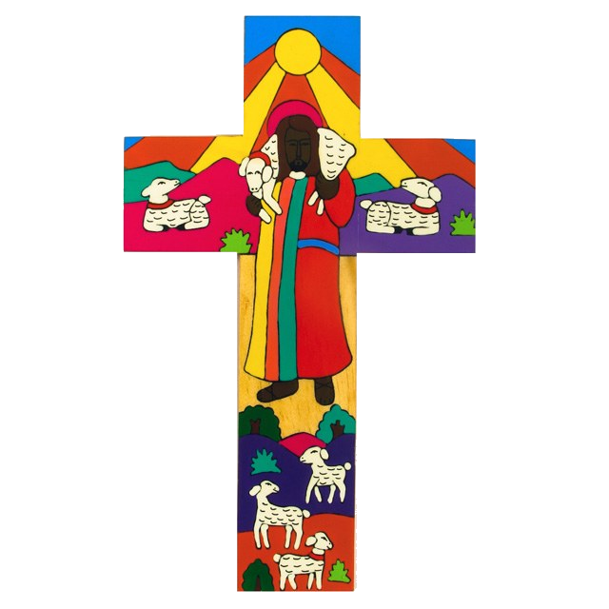
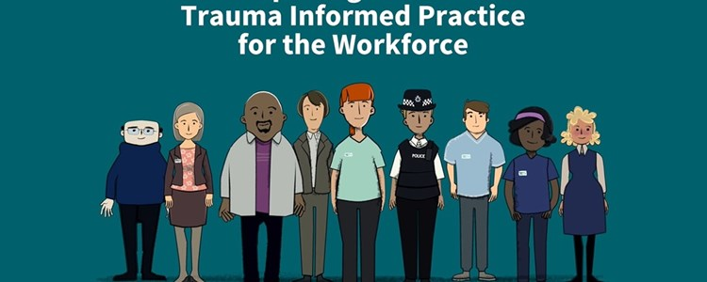


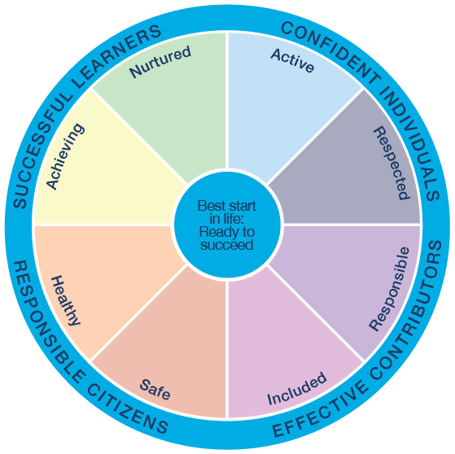
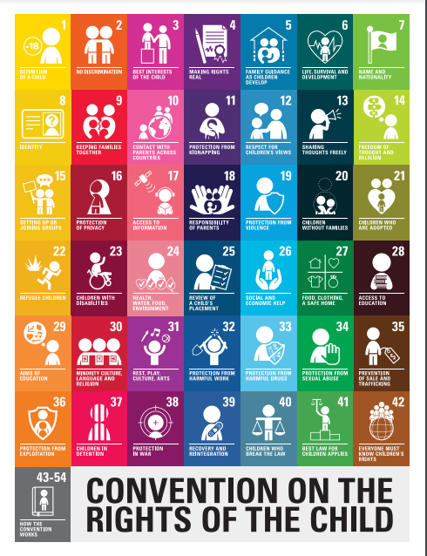



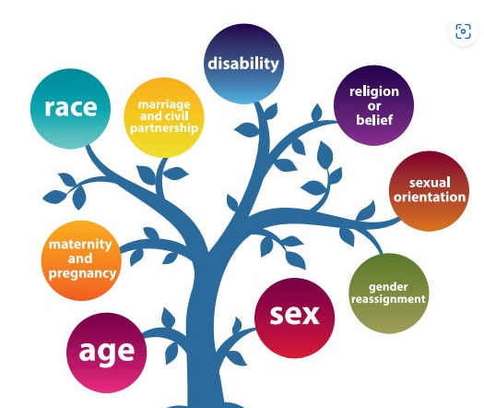
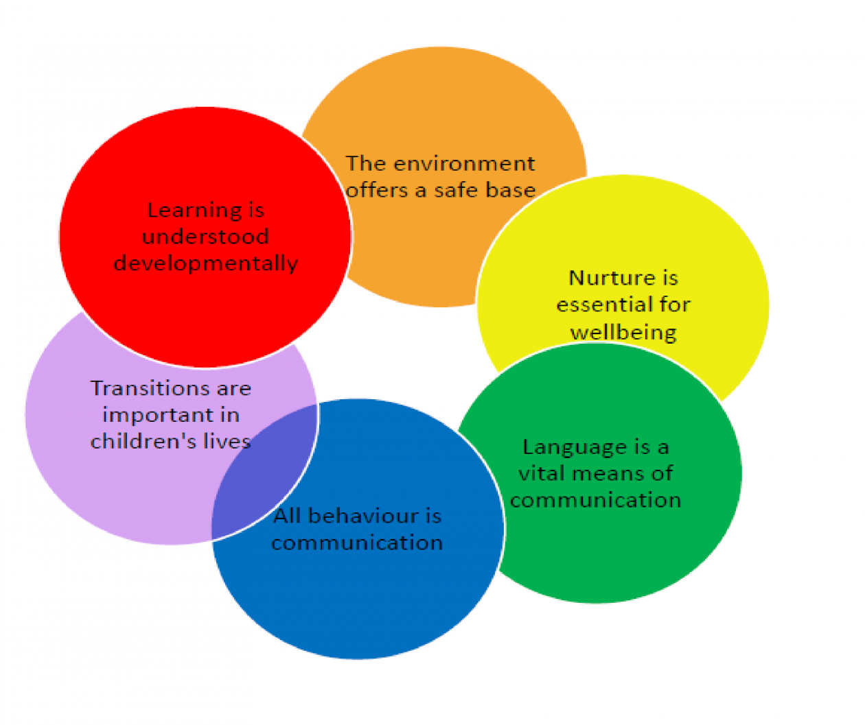

Building Better relationships, better learning, better behaviour at
St Ninian’s RC Primary School
We believe in….
Being trauma informed
The LOVE of God
Celebrating success
The Rights of the Child
Getting it right for every child
Nurturing Approaches
Promoting Equality and diversity

